Slide 1
UX Assessment - Prudential
Vikganesh Mani

Slide 2
Dashboard Wireframes
Wireframes created for the Dashboard UX for web application using Balsamiq tool.

Slide 3
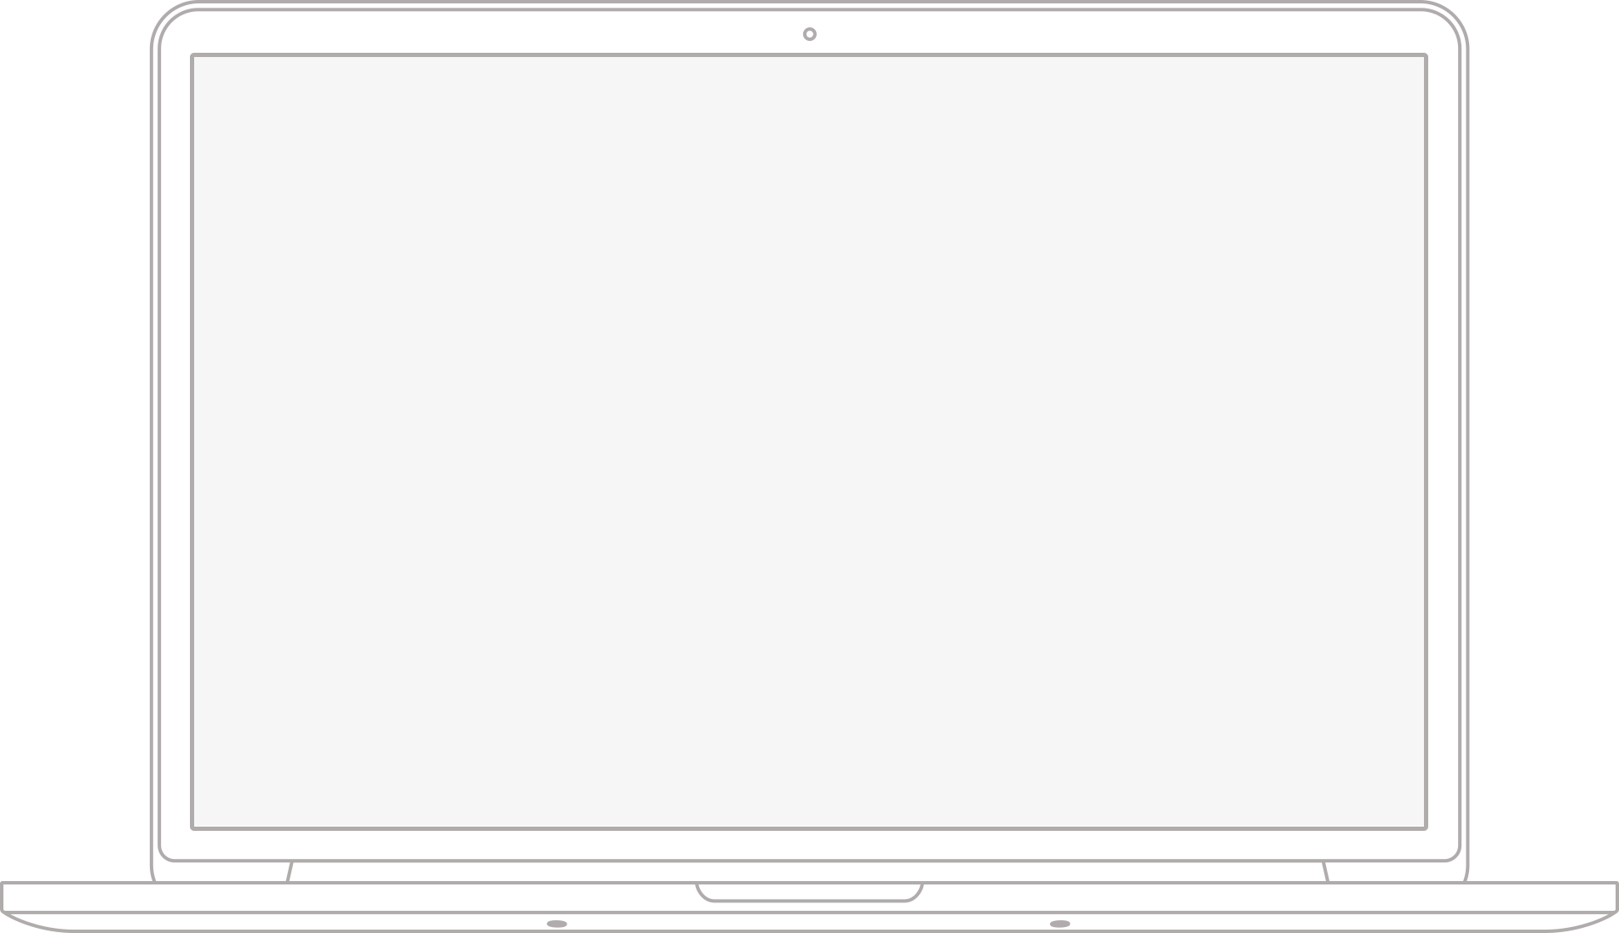
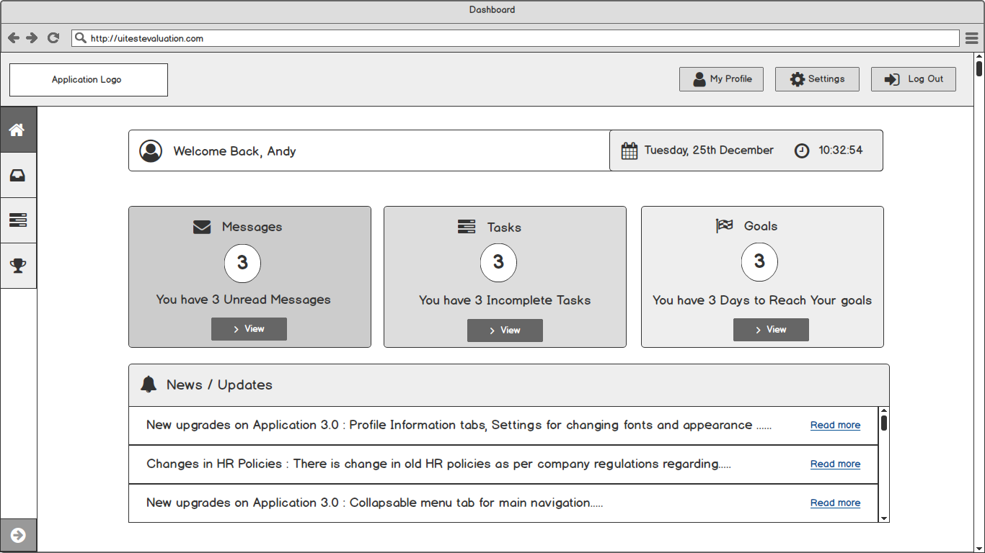
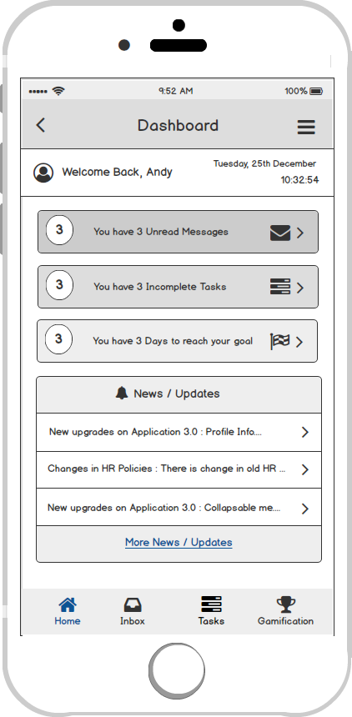
Home Screen - Dashboard
Laptop / Desktop Screen
iPhone Screen

Slide 4
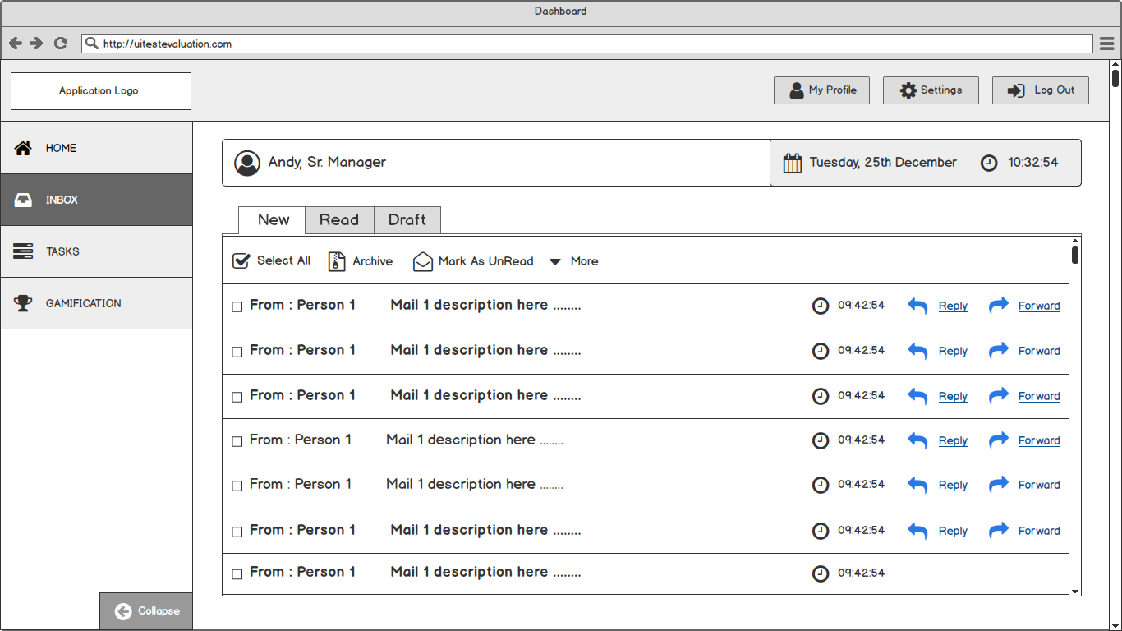
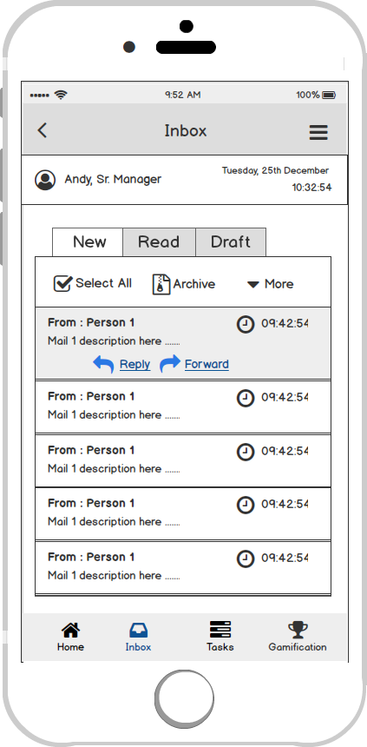
Inbox Screen - Dashboard
Laptop / Desktop Screen
iPhone Screen

Slide 5
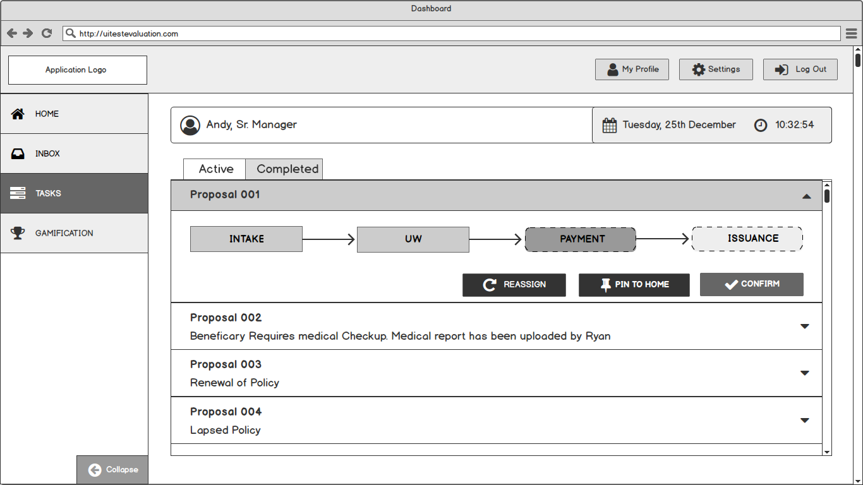
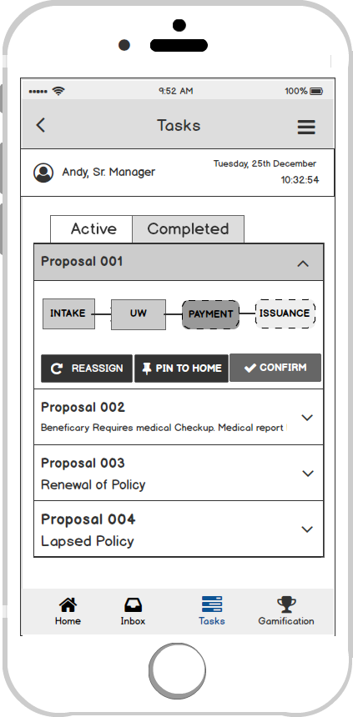
Tasks Screen - Dashboard
Laptop / Desktop Screen
iPhone Screen

Slide 6
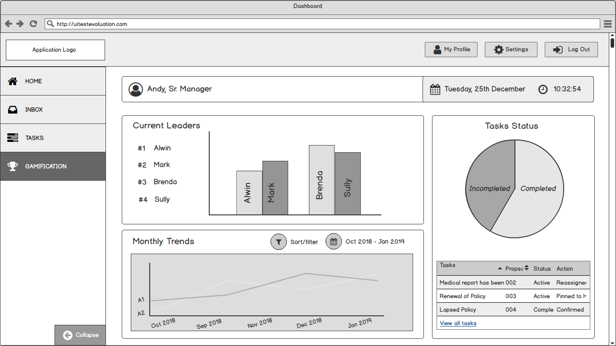
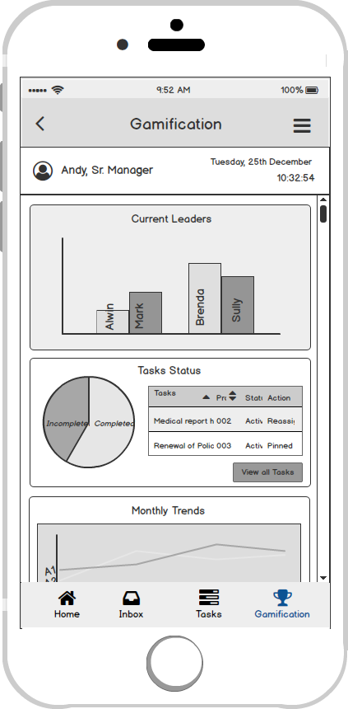
Gamification Screen - Dashboard
Laptop / Desktop Screen
iPhone Screen

Slide 7
Dashboard Mockups
Mockups for Dashboard created using HTML5, Charts.js & Bootstrap.js

Slide 8
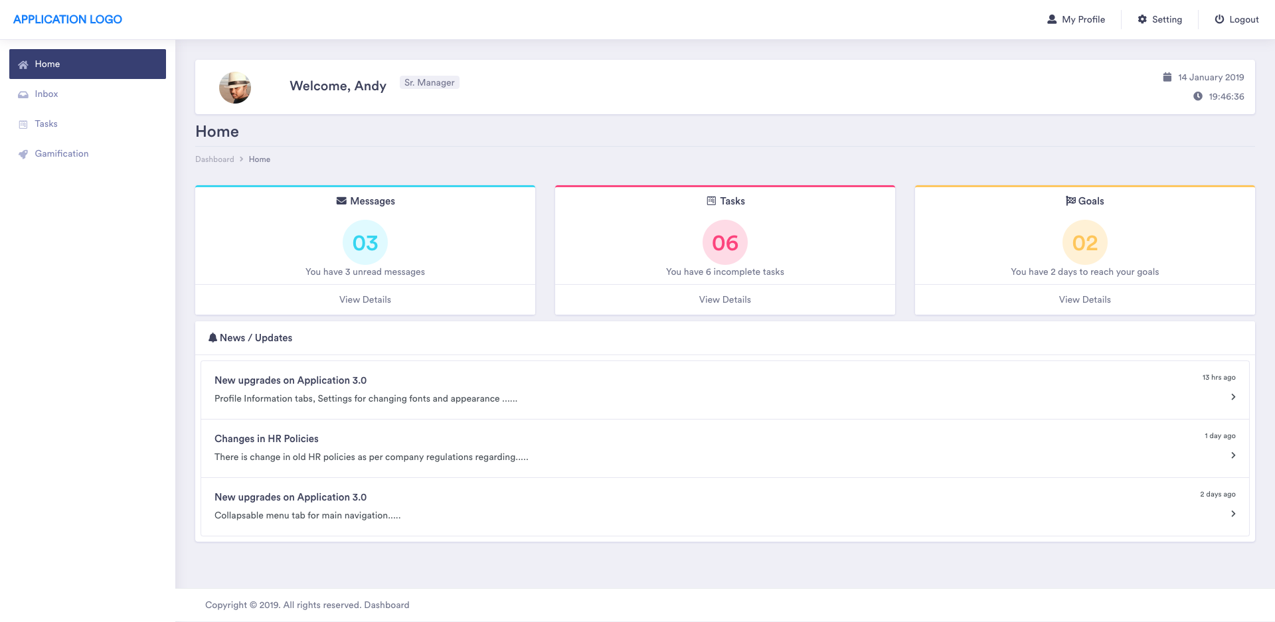
Home Screen - Dashboard

Slide 9
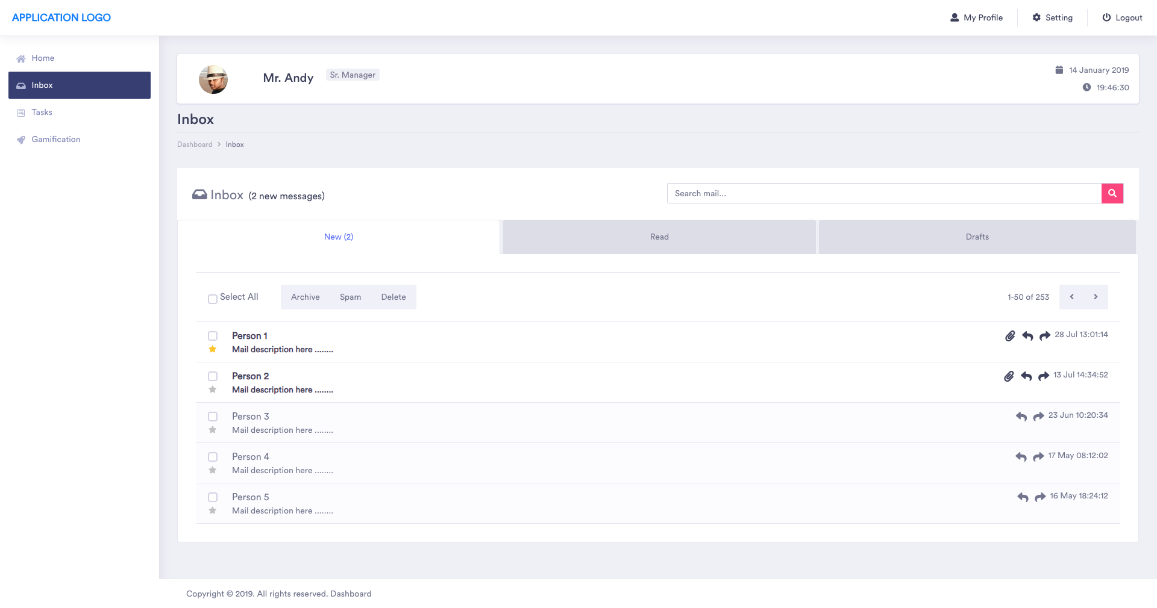
Inbox Screen - Dashboard

Slide 10
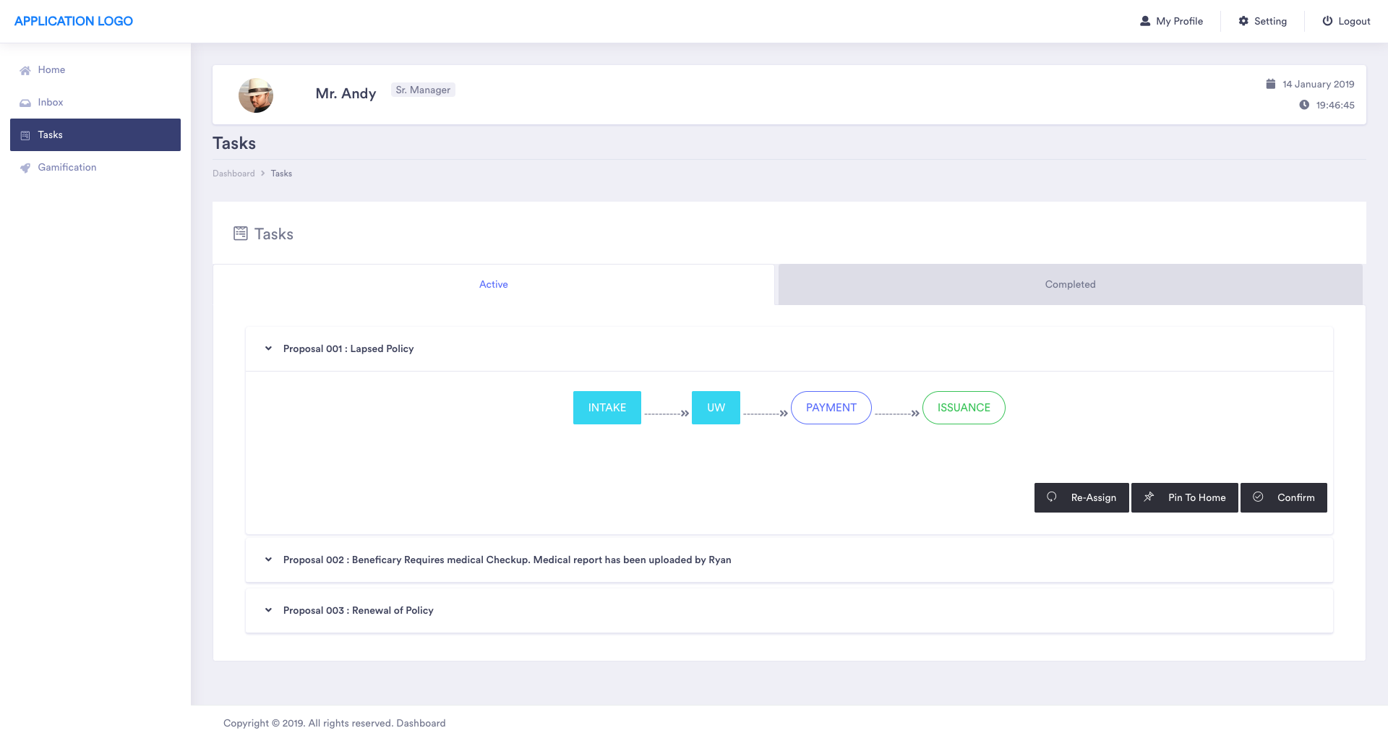
Tasks Screen - Dashboard

Slide 11
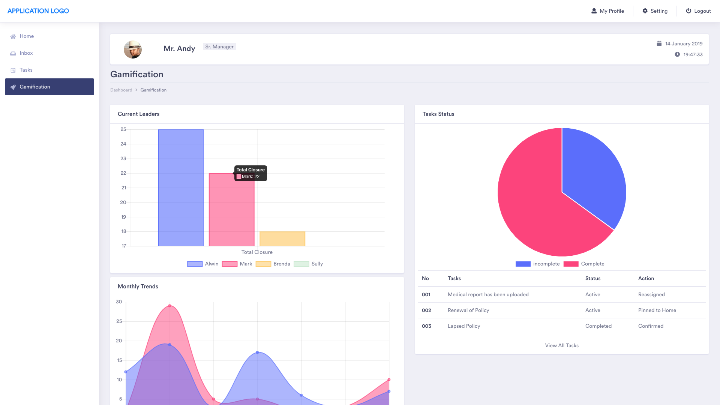
Gamification Screen - Dashboard

Slide 12
Code Submission
Github Repo : https://github.com/viks2590/dashboard.git

Slide 13
Thank You

